Slide 1
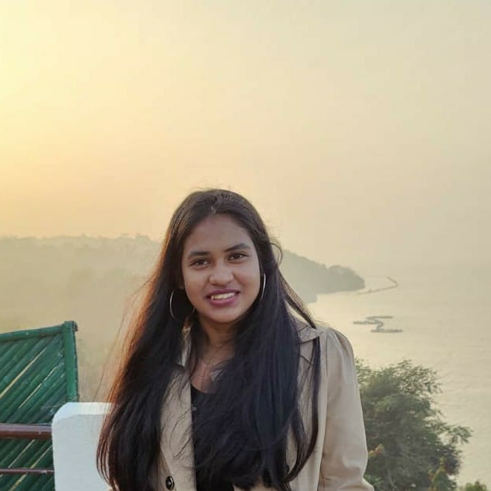

SUSHMITA MAITY
Analyst/Software Engineer
BACHELOR OF ENGINEERING
2017-2021
Skills: Java
Spring Boot
Hibernate
JPA
REST-API
Microservices
Database:
Sql database:Mysql
PostgreSQL
MongoDB
Web Technologies:
HTML5
CSS3
BootStrap
Javascript
React
AddOns:
Github
Maven
Postman
Additional skills:
Quick Learner
Team management
PUNE
Sushmita.maity@capgemini.com
+91 8770234070
A4
Eager to work in a team of dedicated people and serve a key role in the enhancement and development of the project.
Software Engineer who is Good in frontend and backend and integration with intuitive problem-solving skills. Passionate about implementing and launching new projects.
Ready to learn new technologies and implement them to further improve my knowledge.
Has working knowledge on React and Java Microservice Development using Spring framework on an intermediate level.
Check out my work on GitHubhttps://github.com/sushmita206
Shopping cart system:
Completed end to end case study of shopping cart system along with JWT authentication, Swagger and payment testing. . Material-UI and REACT used for user interface.
CropDealManagement:
Completed end to end case study of CropDeal Management
using Microservices ,SpringBoot and React.

